Slide 1



Wildfires and Remobilization of Contaminants in Rural Arizona
By: Cameron Fuse
Dr. Monica Ramirez-Andreotta, Environmental Science
University of Arizona
2024 Space Grant Symposium
April 20, 2024
1

Slide 2
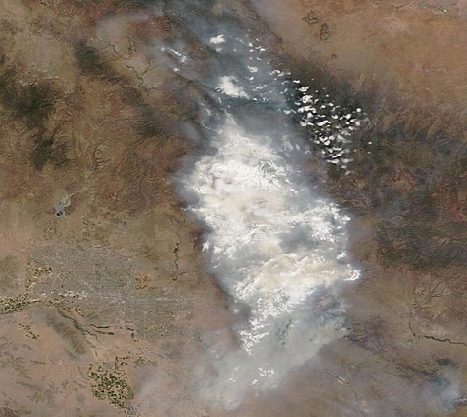
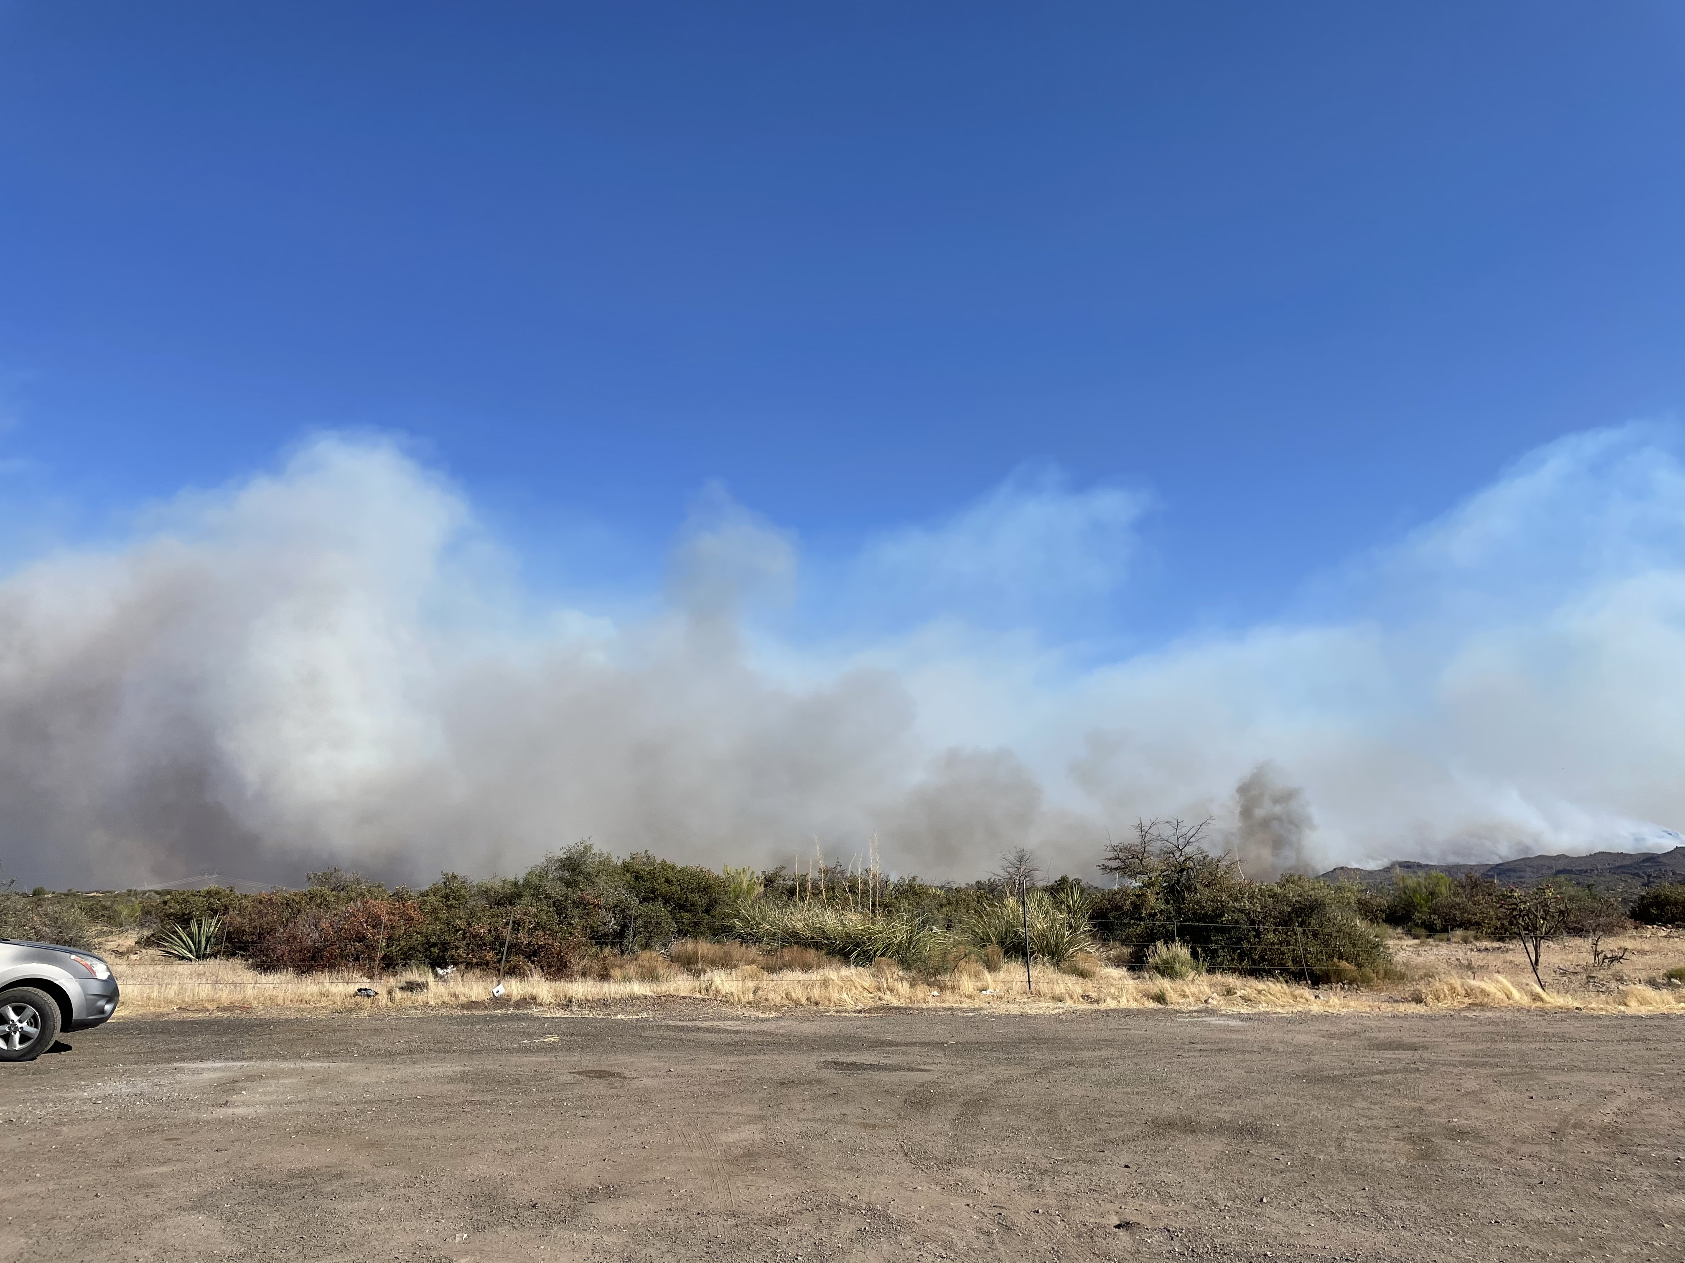
Background
Telegraph Fire:
June 4, 2021 – July 3, 2021.
Located in the Tonto National Forest, roughly 60 miles east of Phoenix.
One of the largest fires in Arizona history, nearly 200,000 acres burned.
Widespread evacuations in the neighboring communities.
Source: https://worldview.earthdata.nasa.gov/
2

Slide 3
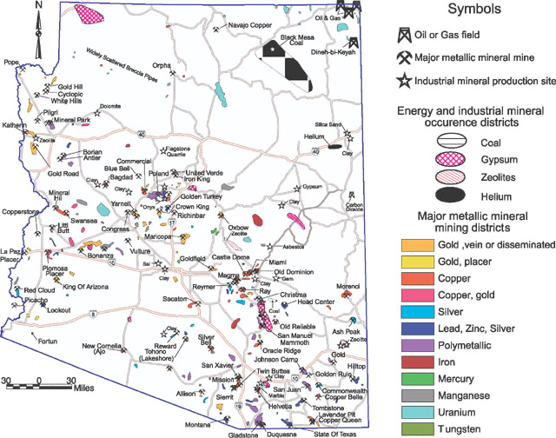
Addressing the Aftermath
Wildfires are detrimental to environmental and human health, but to what extent?
This area is specifically of interest, due to its proximity to mines.
Is dust generated from wildfire-impacted ecosystems proximal to mining leading to increased metal(loids) exposure in nearby communities?
Metal(loids): Arsenic, Lead, Copper, Zinc, Cadmium
Source: https://www.goldmapsonline.com/arizona-gold-mines-and-districts.html
3

Slide 4
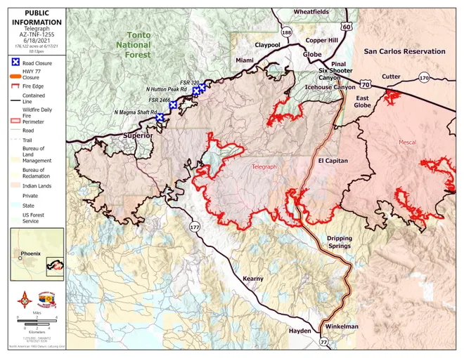
Analyzing Area of Impact
The area impacted was so large that a wide variety of vegetation was impacted by the fire.
Thus, we aim to understand if the burned vegetation has contributed to releasing metal(loids).
We divided the affected area into three subsections (biotic communities) to concentrate our findings.
Source: https://ein.az.gov/files/telegraph-fire-map-6-16-21jpeg
4

Slide 5
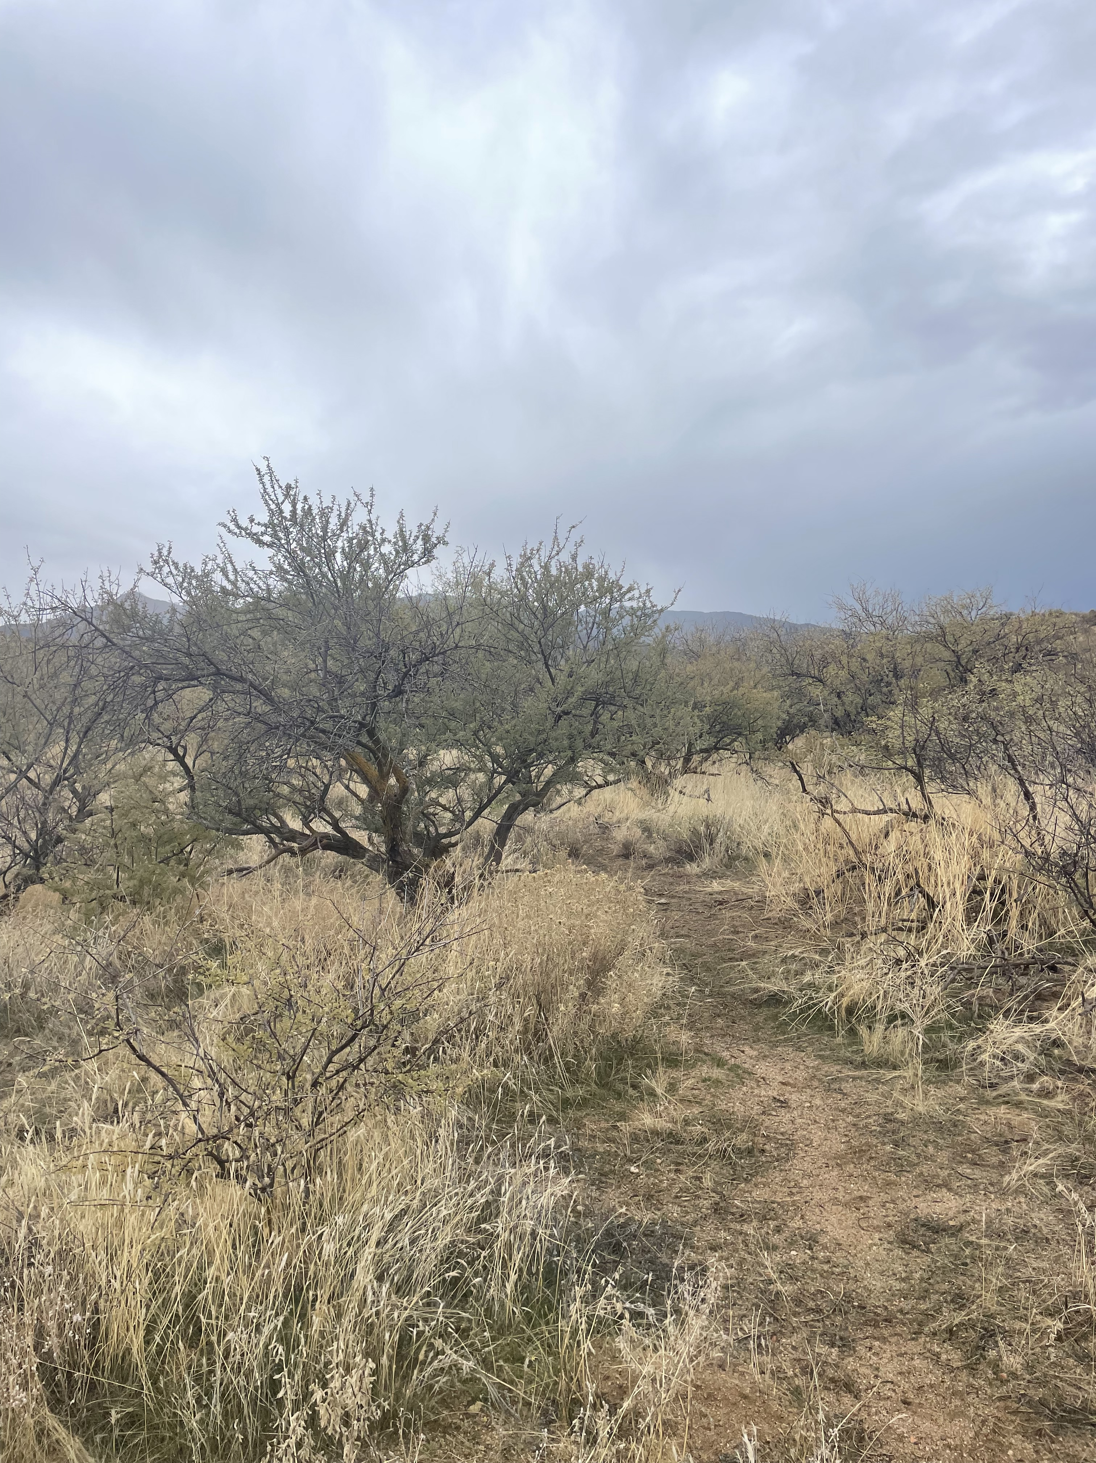
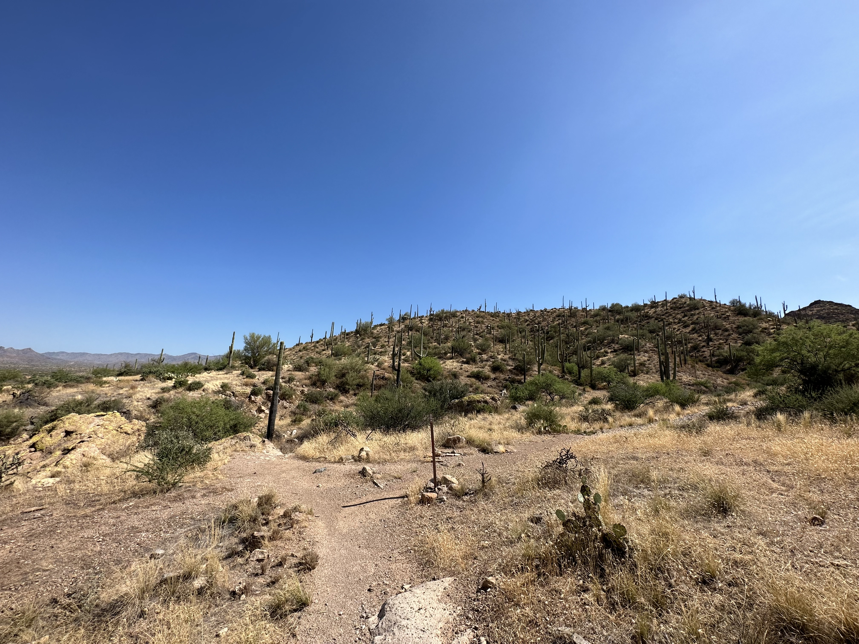
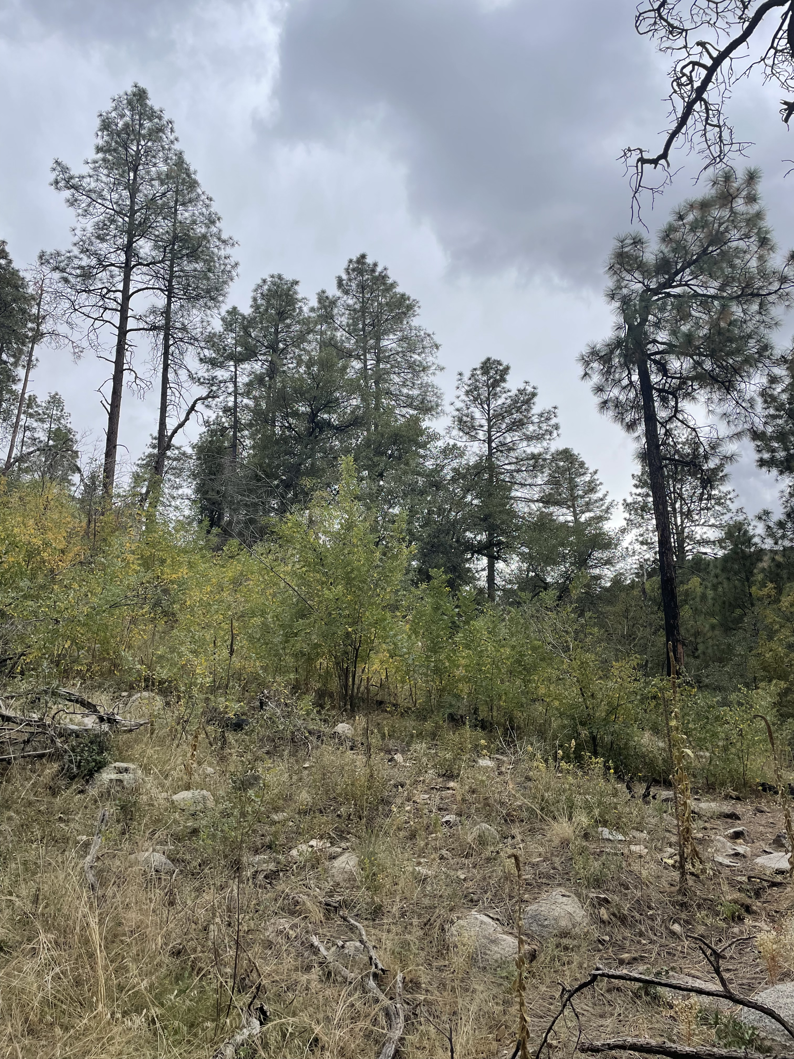
Biotic Communities
The three biotic communities being studied were:
Sonoran Desert Scrub
Interior Chapparal
Madrean Evergreen Woodland
All these biotic communities were impacted by the Telegraph Fire, but to different extents.
Interior Chapparal
Sonoran Desert Scrub
Madrean Evergreen Woodland
5

Slide 6
Burn Severity
Burn Severity, according to the USDA, is the affect of a fire on a ground surface characteristics, such as char depth, color, and structure. This is important to take into consideration and will factor into procedural steps.
Severity Indicators | Low | Medium | High
Definition | Surface organic layers not completely consumed | Up to 80% of the organic layer consumed | All or nearly all of the organic layer consumed
Temperature | <250°C | 250-375°C | >350°C
Appearance | Brown/black soil, green vegetation | Brownish soil, residual scorched vegetation | Light colored, ash of vegetation present
6

Slide 7
Selecting Vegetations
It is important to identify which vegetations are more likely to accumulate metal(loids), which will likely emit these during combustion.
This was done by research via scholar articles/databases, as well as analyzing images of the biotic communities to determine the present vegetations.
These vegetations are known as “hyperaccumulators”.
We hypothesize that the combustion of the hyperaccumulators can contribute into releasing metal(loids) in the form of dust.
Within these biotic communities, different vegetations and hyperaccumulators were identified.
7

Slide 8
Vegetations of Focus
In total, 27 plant species were Identified, however the ones collected were of great abundance and contained more hyperaccumulators than not.
Sonoran Desert Scrub | Interior Chapparal | Madrean Evergreen Woodland
Velvet Mesquite, Catclaw Acacia, Desert Grass, Creosote Bush | Velvet Mesquite, Catclaw Acacia, Desert Grass, Desert Broom | Ponderosa Pine, Arizona Oak, Desert Grass
8

Slide 9
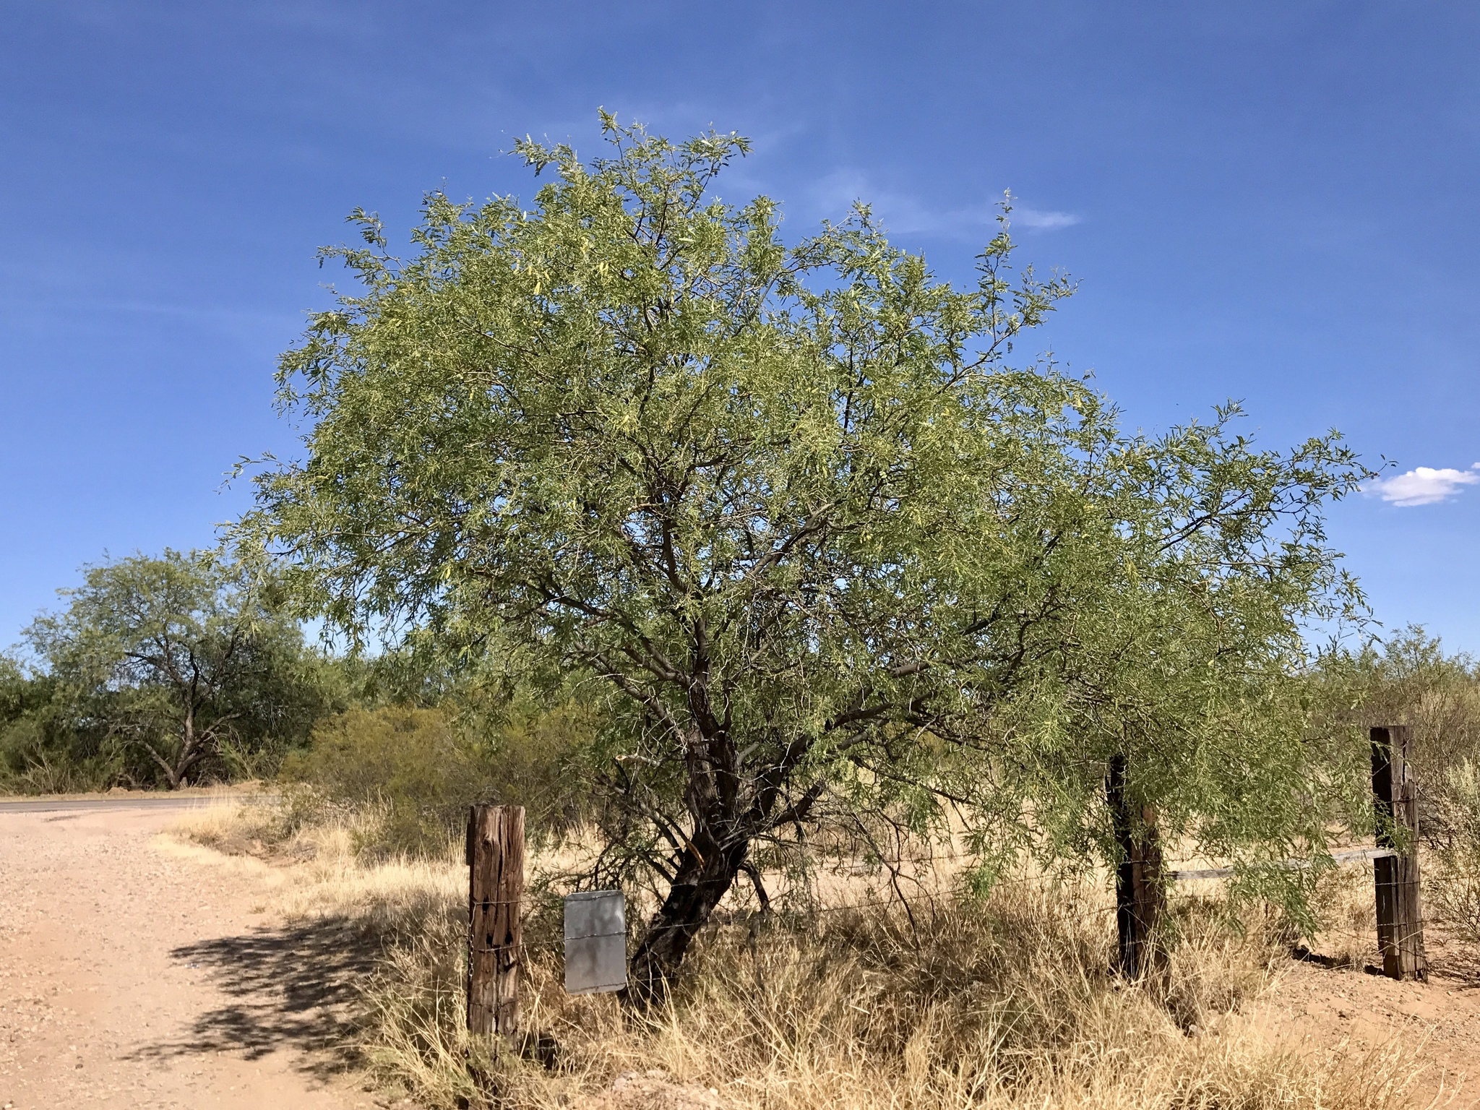
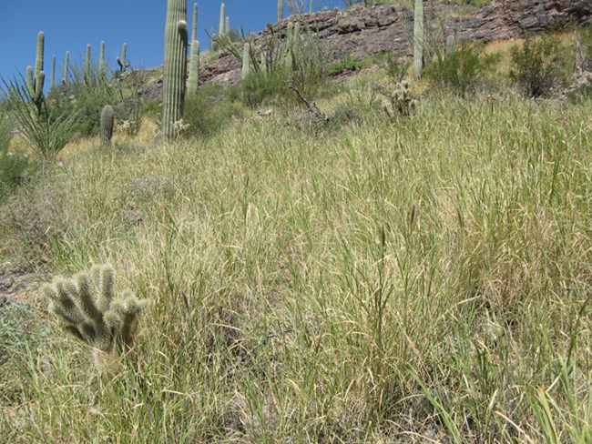
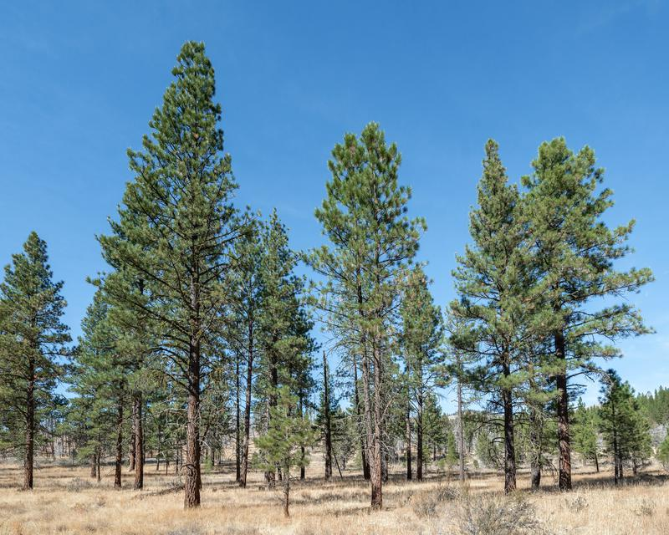
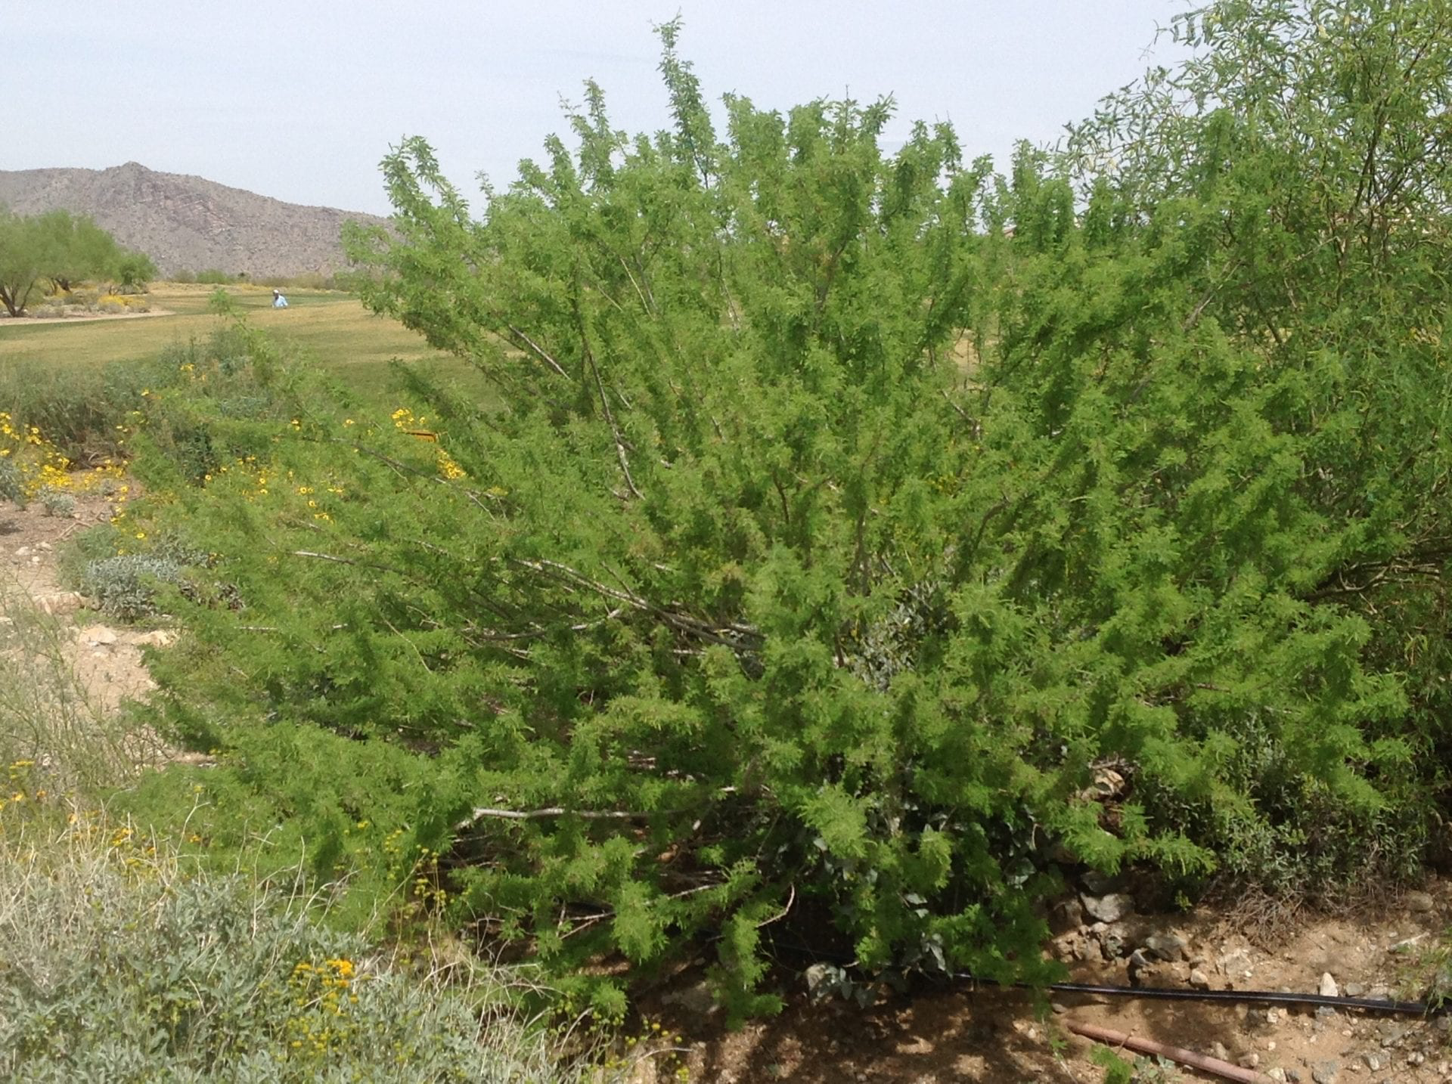
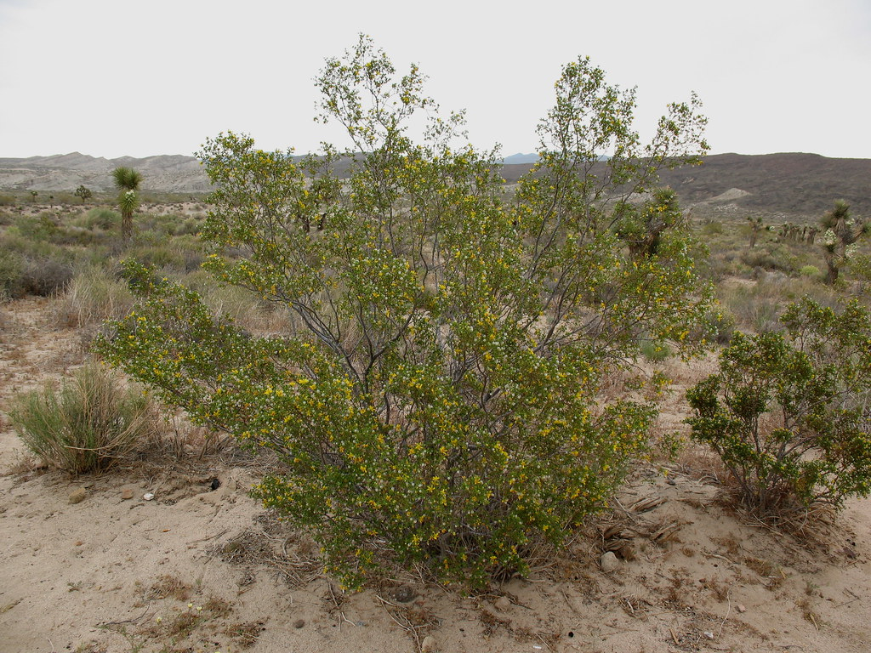
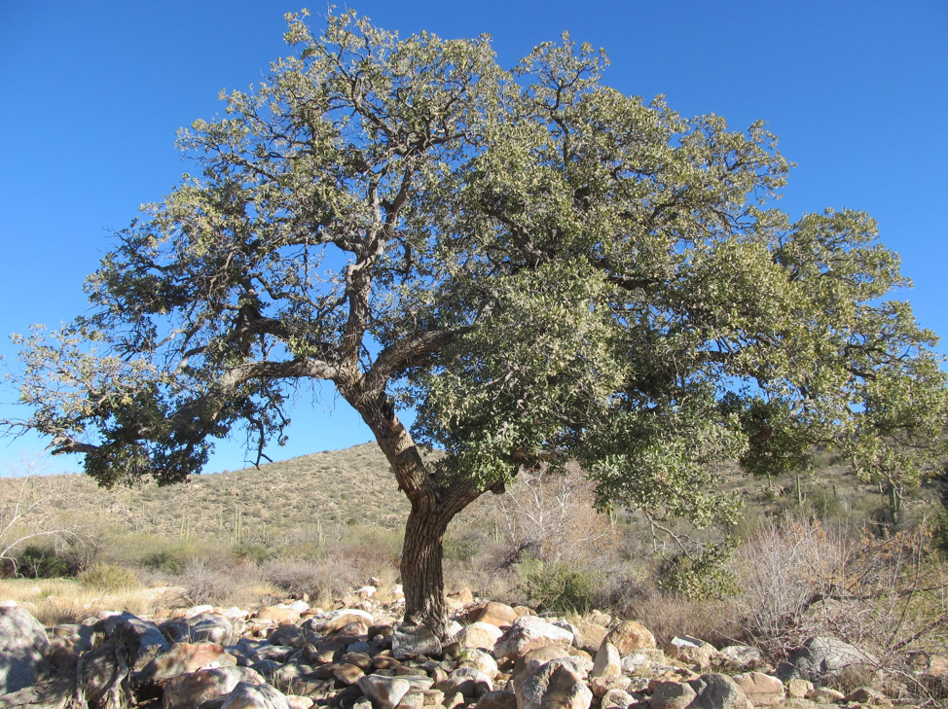
Vegetations of Focus
Velvet Mesquite
Desert Grass
Ponderosa Pine
Source: https://www.nps.gov/sagu/learn/nature/mesquites.htm
Source: https://www.nps.gov/sagu/learn/nature/buffelgrass.htm
Source: https://www.fcgov.com/vegetation/?view=942-ponderosa-pine
Catclaw Acacia
Creosote Bush
Arizona Oak
Source: https://mswn.com/plants/acacia-greggii-catclaw-acacia/
Source: https://earthobservatory.nasa.gov/biome/seedcreosote.php
Source: https://wtufc.org/index.php/wiki/arizona-white-oak-quercus-arizonica/
9

Slide 10
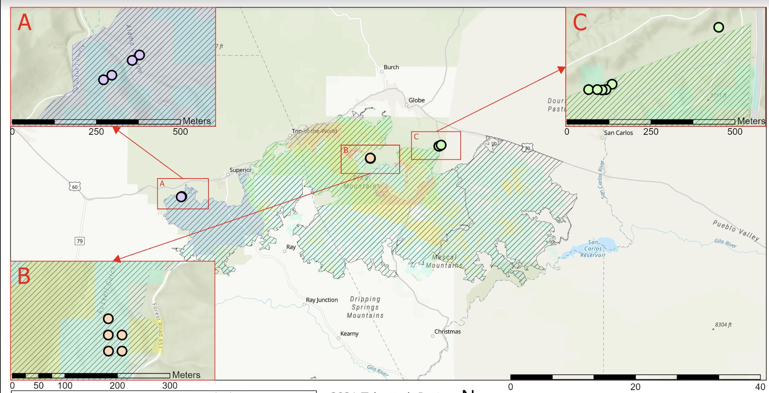
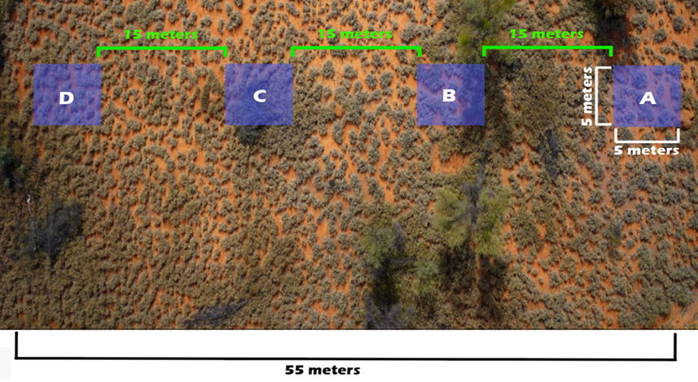
Sampling Methodology
Sampling locations are areas within the wildfire perimeter, have an abundance of vegetation, and are accessible.
These areas are away from any human activity (e.g. at least 50m from paved roads).
Each Biotic Community has transects that are 5x5 meters wide and 15 meters apart.
10

Slide 11
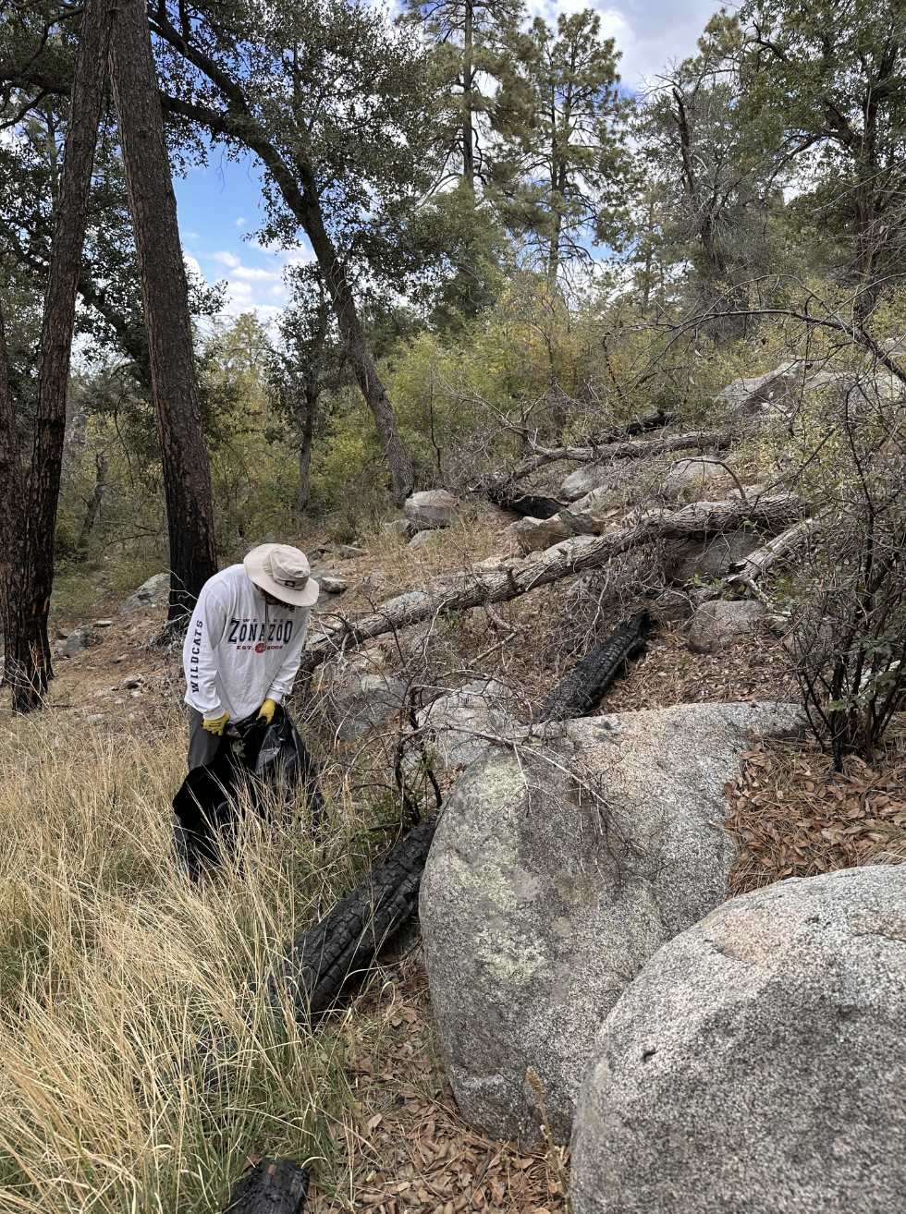
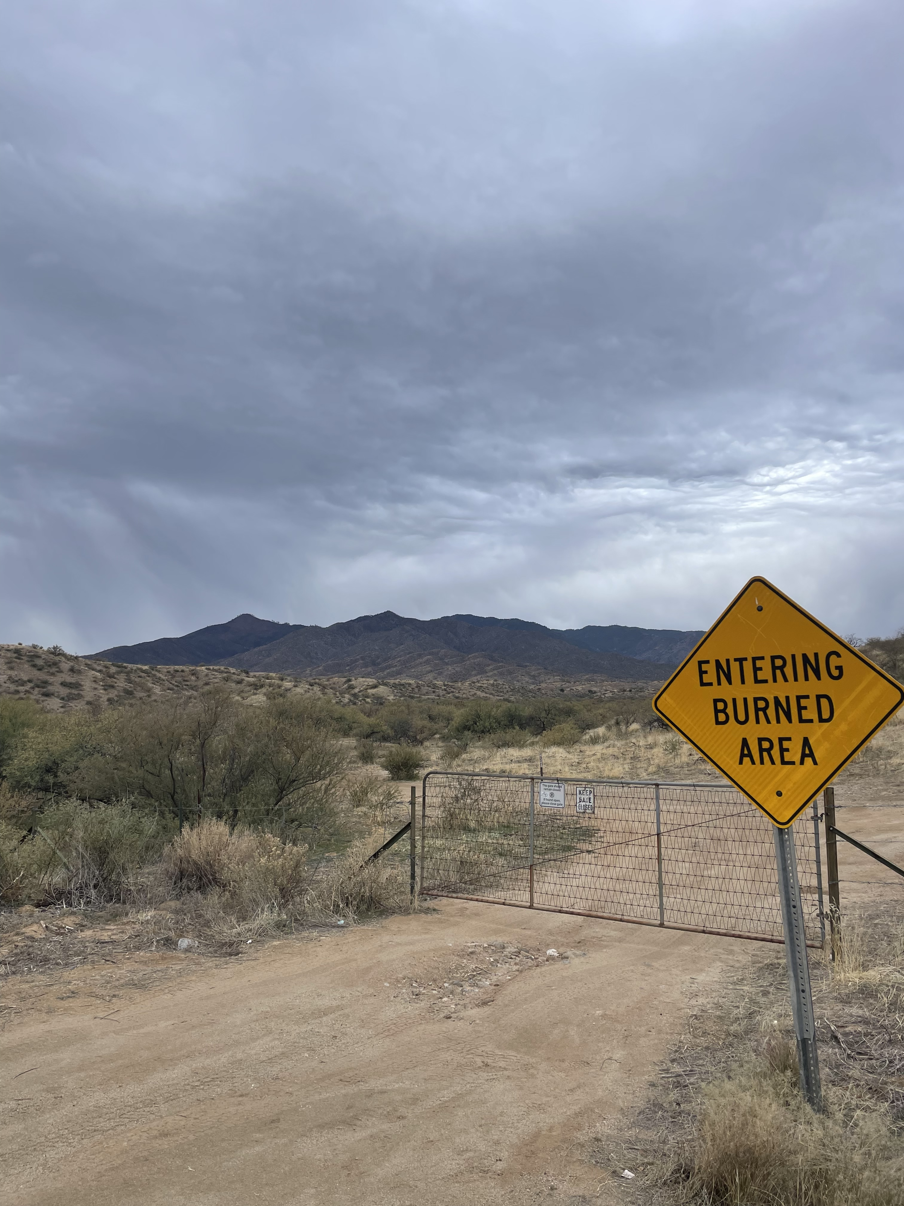
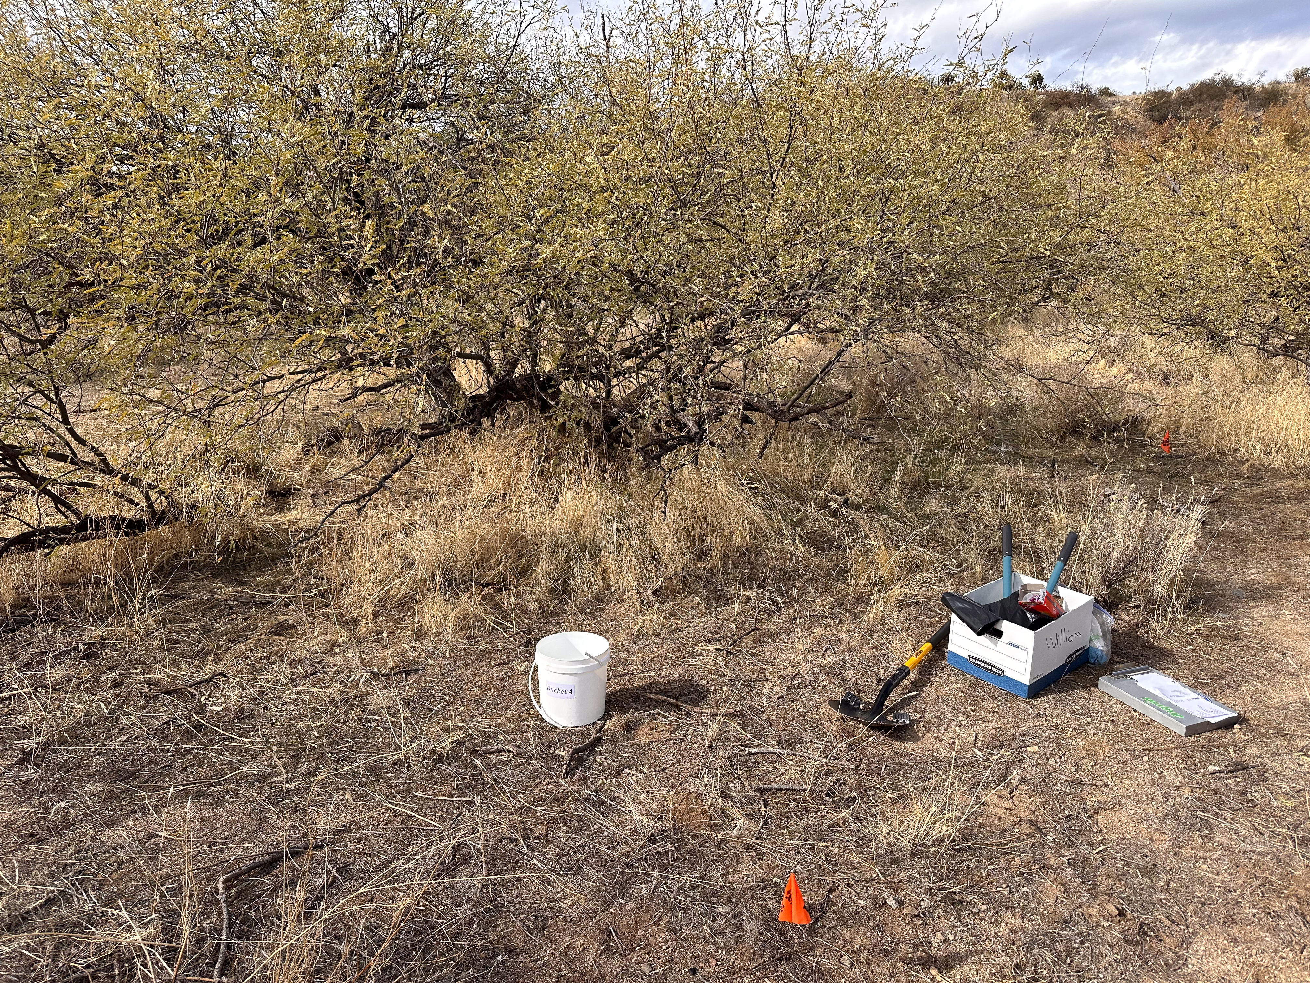
Sampling
Collection of the vegetation occurred over two days.
Procedure:
Collect four different vegetation samples from each transect. More is better.
Remove primarily leaves and bark, root when necessary.
Avoid already burned vegetation.
Collect soil to analyze burn severity.
11

Slide 12
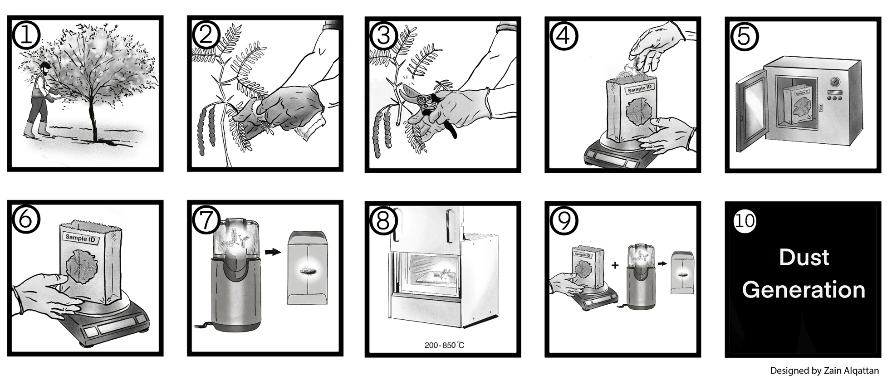
Procedure
Oven Drying
12
Notes:
Once we finished from the field, the plant samples were brought to the lab to be further processed. A series of steps were followed to get these samples ready for the dust generation. For example, from picture 2 to 6, samples were cleaned, homogenized and oven dried to a constant weight. This allows us to get a sub portion which will be our control samples. Then samples were burned through different temperatures to capture the variation of the burn severity as shown in picture 8. Again, we take a sub portion of each burning trial.

Slide 13
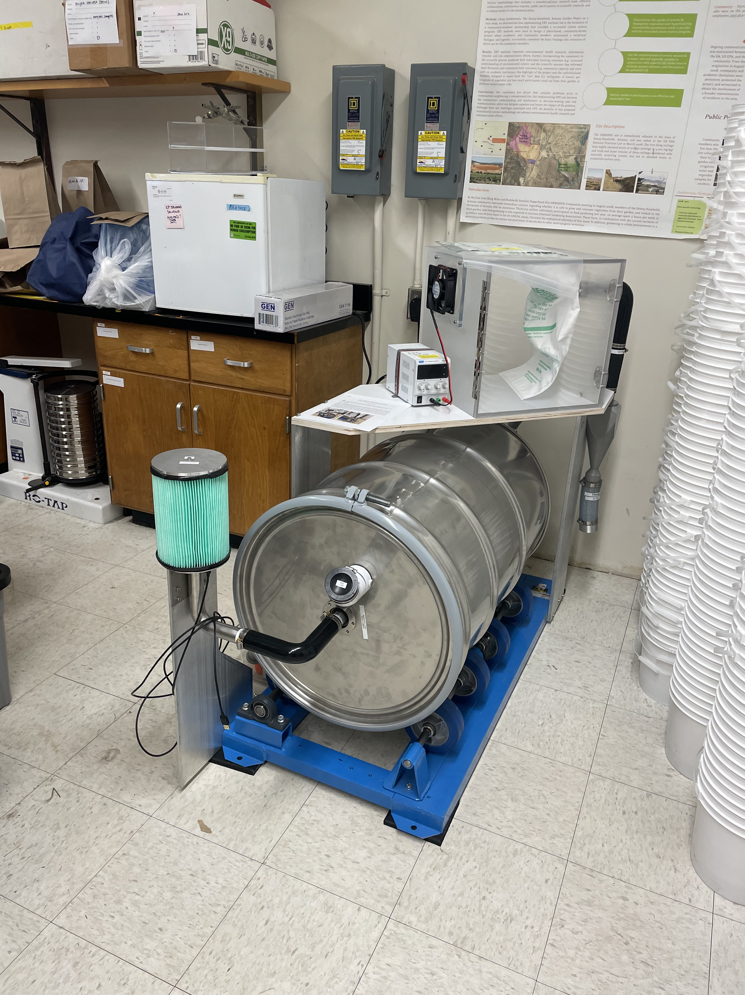
Next Steps
Now, each sample will be run through the dust generator and the dust will be collected.
Once complete, the dust will be analyzed via nitric acid microwave digestion (EPA 3051) and plasma mass spectrometry to determine its elemental composition.
Expectation is to find elevated metal(loid) concentrations.
We can communicate our generated results to rural communities in preparation for future wildfire events.
Dust Generator
13

Slide 14
Acknowledgements
The University of Arizona and the Department of Environmental Science
Arizona Space Grant Consortium
Mentors: Dr. Monica Ramirez-Andreotta, Zain Alqattan and William Borkan
Undergraduate/Graduate students that made this project possible.
14

Slide 15
Thank You!

